Slide 1
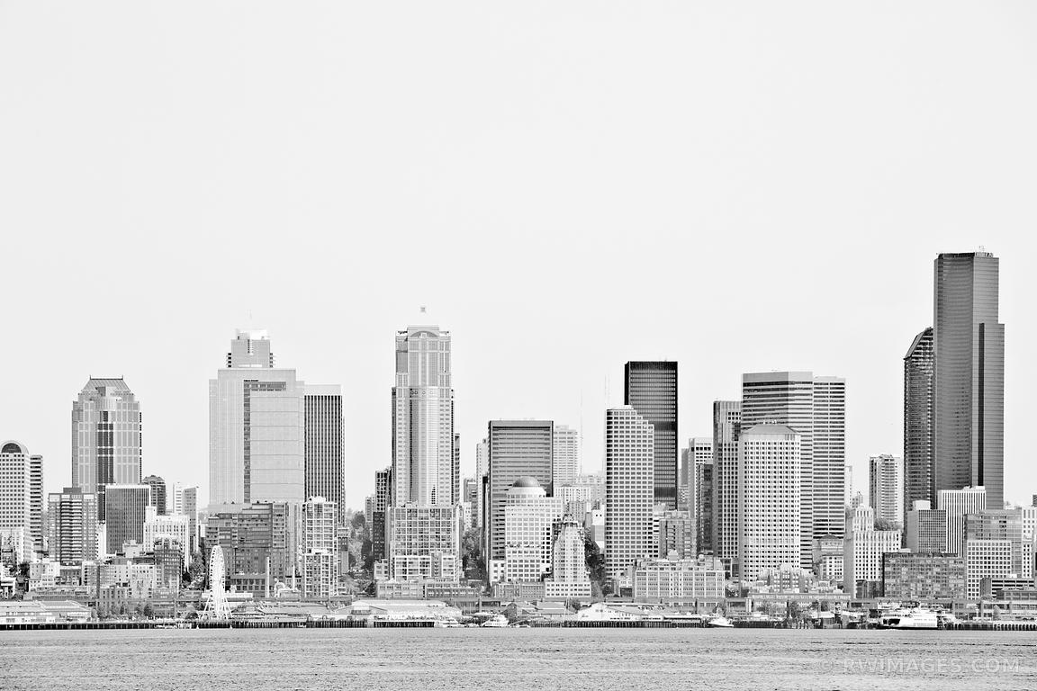
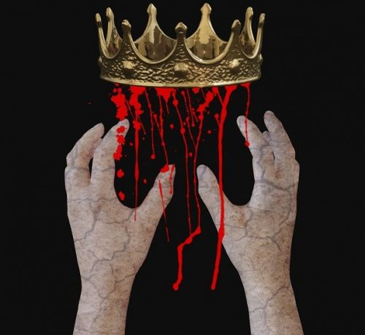
Carre’s Grammar School Presents…
MACBETH 2019
Friday March 15th at 6:30pm
Saturday March 16th at 7pm Main Hall, Doors Open At 6pm Fri /6.30pm Sat
Adults £3 Children £1
TICKETS ON SALE NOW FROM THE SCHOOL OFFICE

