Slide 1

Learning Mindsets

Slide 2
About us
Steve Oakes
Teacher – GCSE and A Level, 17 years
Head of Department, Head of Year
Assistant Director of Sixth Form
Teacher, Researcher, Author, Education Trainer
Martin Griffin
Teacher – GCSE and A Level, 20 years
Head of Department, Head of Year, Assistant Headteacher
Deputy Headteacher, Director of Sixth Form
Teacher, Author, Education Trainer

Slide 3
Project Outline
Five non-cognitive characteristics and their impact on student behaviours, attitudes and consequent performance
Encourage schools to take part
Train the trainers
Delivery of training to tutor group teams
Delivery of support and intervention materials
Evaluation

Slide 4
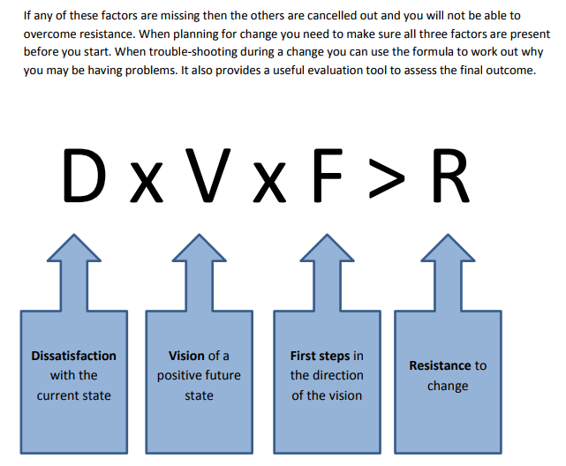

Slide 5

Why do some students
underperform?

Slide 6
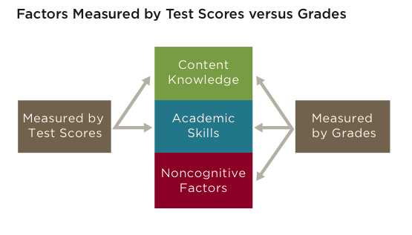

Slide 7
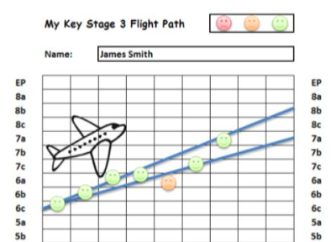
Two Issues

Slide 8
Micromanagement
Passivity
Impostor syndrome, expressed through anti-intellectualism
The locus of control lies with the organisation not the individual
Infantilisation: sense of them vs us
Lack of tools and strategies for self-regulation
Issues around proactive problem-solving
Little experience of long-term project management
Lack of involvement in extra-curricular activities that enhance cultural capital or encourage curiosity

Slide 9


Slide 10
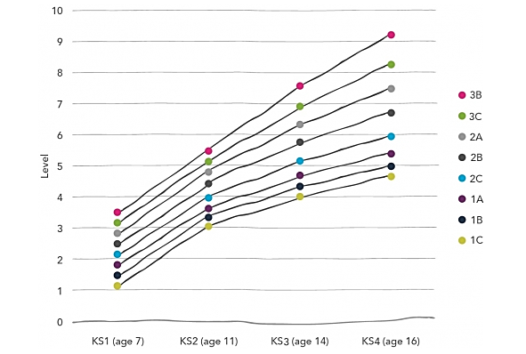

Slide 11
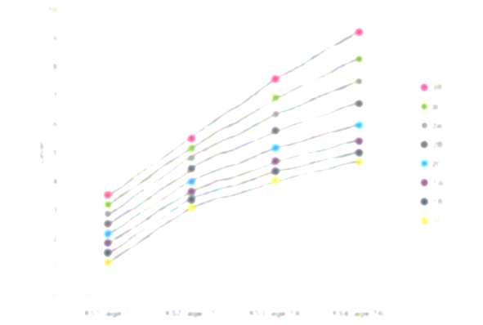
“We have an accountability system that has encouraged schools to check that children are making a certain number of sub-levels of progress each year.”
“Take a child’s attainment at age 7, look up the average attainment for children at the same level by age 11 and draw a straight line between the two assuming that linear progress will be made in each of the four intervening years.”
Michael Treadaway ‘Why Measuring Pupil Progress Involves More Than Taking a Straight Line.’ (FFT 2016)

Slide 12
“But do children normally take such smooth learning journeys as they acquire knowledge and understanding in a subject as our accountability system assumes? And is it reasonable to deem children as ‘on target’ or ‘in need of intervention’ using this approach?”
“By reviewing the data we find that only --- of pupils take the expected pathways through Key Stage Two, Key Stage Three and Key Stage Four Levels.”
Michael Treadaway ‘Why Measuring Pupil Progress Involves More Than Taking a Straight Line.’ (FFT 2016)

Slide 13
“But do children normally take such smooth learning journeys as they acquire knowledge and understanding in a subject as our accountability system assumes? And is it reasonable to deem children as ‘on target’ or ‘in need of intervention’ using this approach?”
“By reviewing the data we find that only 9% of pupils take the expected pathways through Key Stage Two, Key Stage Three and Key Stage Four Levels.”
Michael Treadaway ‘Why Measuring Pupil Progress Involves More Than Taking a Straight Line.’ (FFT 2016)

Slide 14
“Children are likely to make cognitive leaps and pauses at different times for a variety of reasons.”
Michael Treadaway ‘Why Measuring Pupil Progress Involves More Than Taking a Straight Line.’ (FFT 2016)

Slide 15
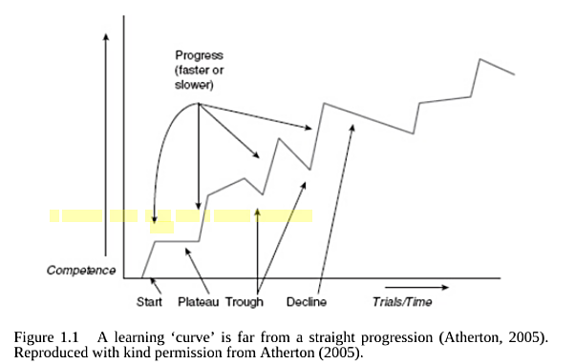
James Atherton, De Montfort University (2005)

Slide 16
The cognition narrative
‘I’m afraid they’re just not a linguist/scientist/artist/musician.’
‘We have squeezed every ounce out of them at GCSE. There’s nothing left.’
‘Give me some decent kids, and I’ll give you some decent results.’
‘Well we can’t expect too much of them. They come from such difficult backgrounds.’
‘The step up in my subject is massive.’
Notes:
9.45 – 9.50
Any instutition going from good to outstanding – will hear ‘stories’ about why the final step is impossible. These usually come from middle leaders... Can you think of others.....
The first key to unlocking potential is recognise that these stories are not true.

Slide 17
Vision: How well do you know what you want to achieve?
Effort: How many hours of independent work do you do?
Systems: How do you organise your learning and organise your time?
Practice: What kind of work do you do to practice your skills?
Attitude: How do you respond to setbacks?

Slide 18

The low vision student
Characterised by listlessness, boredom, low-level anxiety, exasperation, and a tendency to procrastinate

Slide 19
Vision – Key Principles
Dream v Goal (a bias towards action)
‘Purpose’ beats ‘status’
Short term/long term

Slide 20


Slide 21
Three things a High/Low Vision student in your context does every lesson/every day/every week….
Low High

Slide 22
Three things a High Vision student in your context does this every lesson/every day/every week….
Asks questions, often staying behind after class
Makes connections with previous learning – explores the ‘adjacent possible’; curious
Understands the role and value of the subject in a wider context – news stories, TV, social

Slide 23
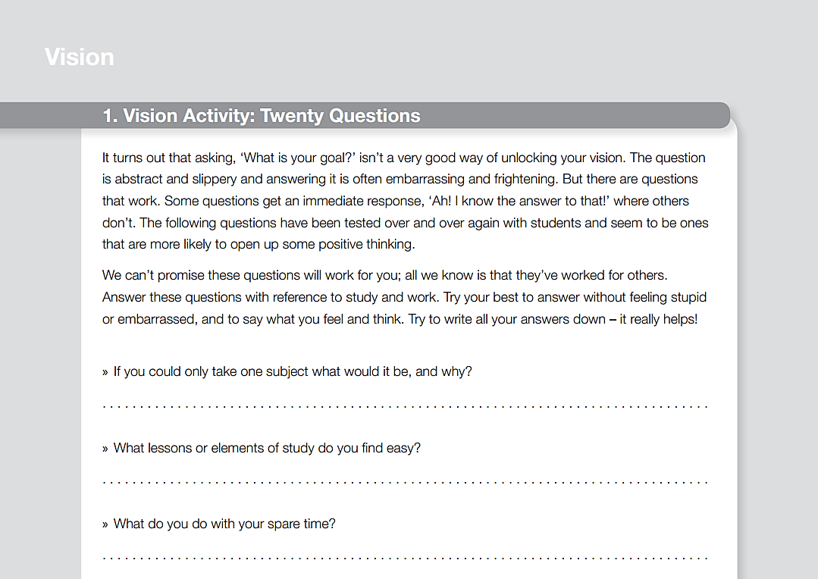

Slide 24
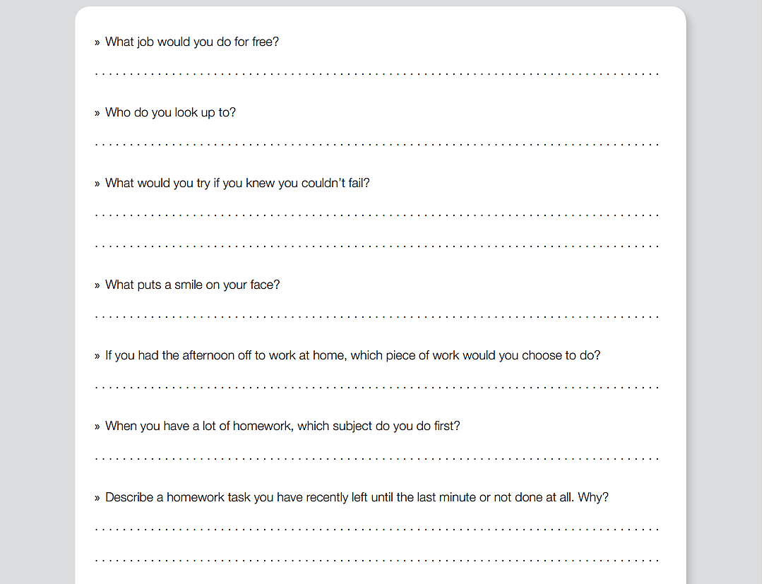

Slide 25

The low effort student
Characterised by satisfaction, contentment and short-termism – oblivious to levels of hard work put in by others.

Slide 26
Effort – Key Principles
Measuring effort – knowing the standards
Perceptions of effort are relative
Comfort zones

Slide 27
Three things a High/Low Effort student in your context does every lesson/every day/every week….
Low High

Slide 28
Three things a High Effort student in your context does this every lesson/every day/every week….
Knows what an hour will be spent doing before it starts
Chooses high-effort spaces to work
Has a series of pro-active activities to complete regardless of teacher instruction

Slide 29
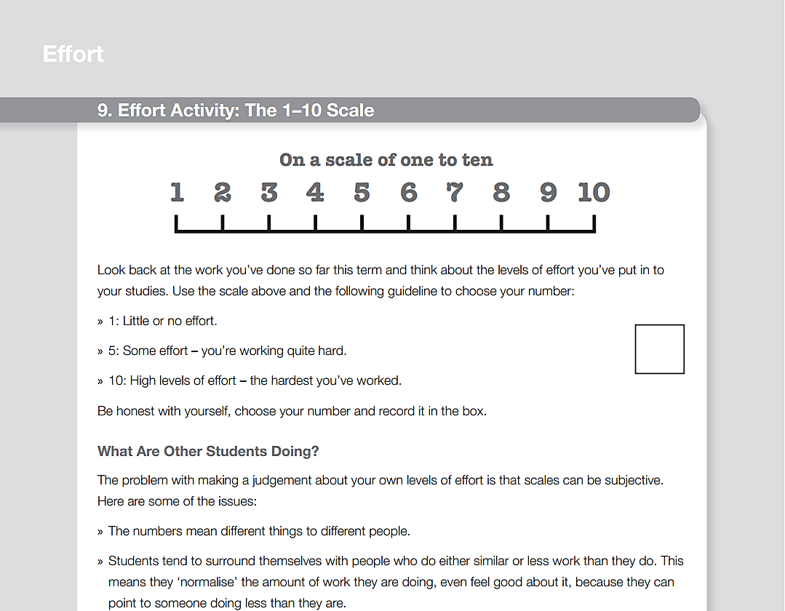

Slide 30
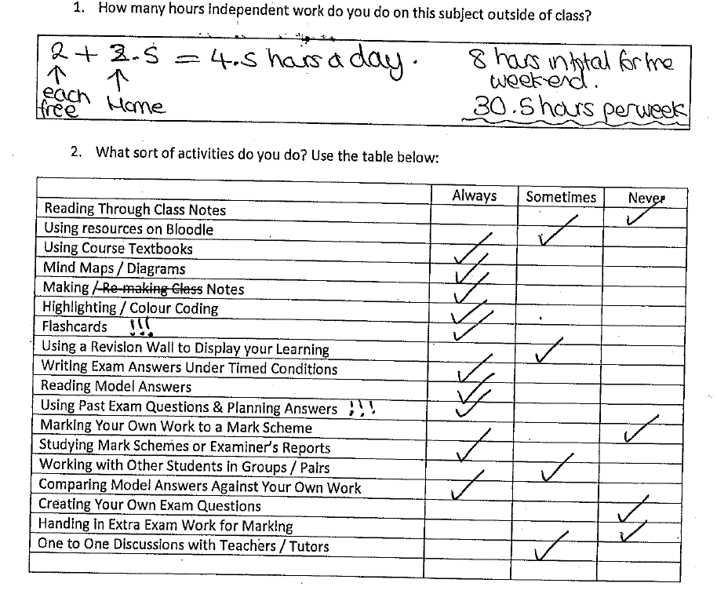

Slide 31
hpw | percentage of students
0-4
4-8
8-12
12-16
16-20
20+

Slide 32
hpw | percentage of students
0-4 | 3% 3
4-8
8-12
12-16
16-20
20+

Slide 33
hpw | percentage of students
0-4 | 3% 3
4-8 | 11% 14
8-12
12-16
16-20
20+

Slide 34
hpw | percentage of students
0-4 | 3% 3
4-8 | 11% 14
8-12 | 21% 35
12-16
16-20
20+

Slide 35
hpw | percentage of students
0-4 | 3% 3
4-8 | 11% 14
8-12 | 21% 35
12-16 | 25% 60
16-20
20+

Slide 36
hpw | percentage of students
0-4 | 3% 3
4-8 | 11% 14
8-12 | 21% 35
12-16 | 25% 60
16-20 | 11% 71
20+

Slide 37
hpw | percentage of students
0-4 | 3% 3
4-8 | 11% 14
8-12 | 21% 35
12-16 | 25% 60
16-20 | 11% 71
20+ | 28% 99

Slide 38

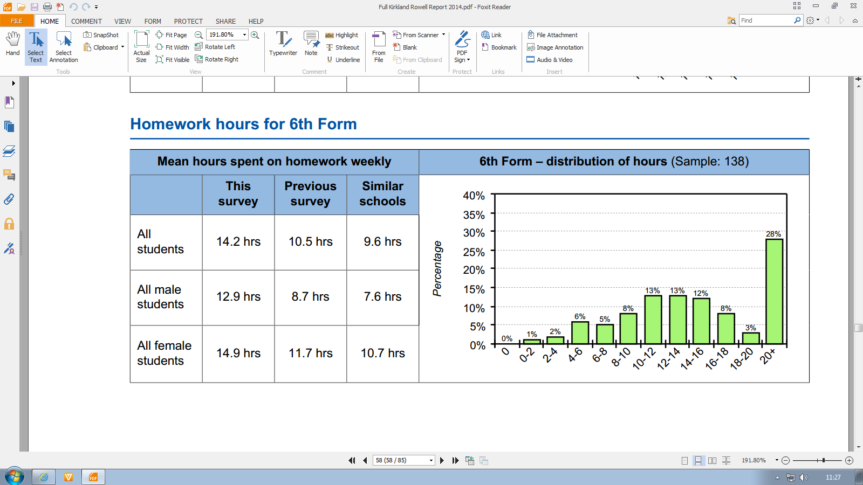

Slide 39
Three Types of Work

Slide 40
Three Types of Work

Slide 41
Three Types of Work

Slide 42
Three Types of Work

Slide 43
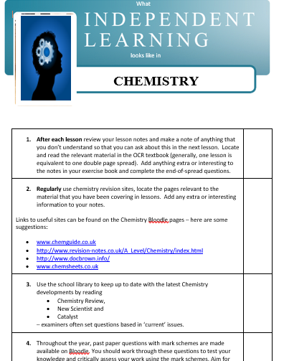

Slide 44

The low-systems student
Characterised by a scaling-up of old systems that now can’t cope, missing deadlines because the work has been forgotten, poor sleep and late waking, chaotic bags and folders, often high-stress

Slide 45
Systems – Key Principles
Project management
Collecting and capturing
Resources/time

Slide 46
Three things a High Systems student in your context does every lesson/every day/every week….
Low High

Slide 47
Three things a High Systems student does every lesson/every day/every week….
Reviews files and learning materials
Looks ahead to next week and anticipates tricky periods of time
Organises work thematically not chronologically

Slide 48
High quality
Behind schedule
Ahead of schedule
Low quality

Slide 49
Extreme | High | Medium | Low | Idle
2 | 4 | 8 | 4 | 2

Slide 50

Extreme | High | Medium | Low | Idle
2 | 4 | 8 | 4 | 2

Slide 51
Extreme | High | Medium | Low | Idle
2 | 4 | 8 | 4 | 2

Slide 52

The low practice student
Often organised and hardworking but loyal to repeated patterns of GCSE preparation, comfortable behaviours, sense of control achieved through large stationery purchases, claims “you can’t revise” for skills-based courses

Slide 53
Practice - Key Principles
Know the skills
Practice under a variety of conditions
Reinforce high expectations of practice

Slide 54
Three things a High Practice student in your context does every lesson/every day/every week….
Low High

Slide 55
Three things a High Practice student does every lesson/every day/every week….
Completes ‘content’ learning as the course goes on
Gathers past paper questions and attempts sections/full papers
Strategically reviews progress, looks for weaknesses and focuses on them

Slide 56


Slide 57
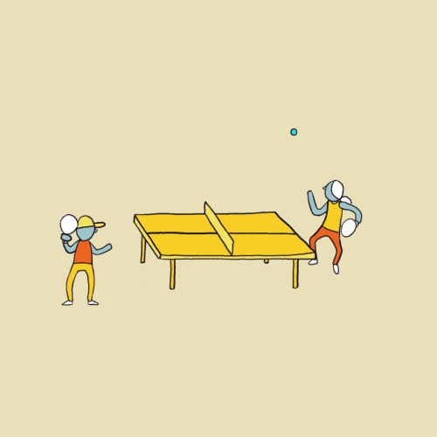


Slide 58

High practice spaces
Establishing in-game basic moves: breaking into component parts
Drills for fine-tuning component parts
Competition and feedback
Deliberate increase in challenge

Slide 59
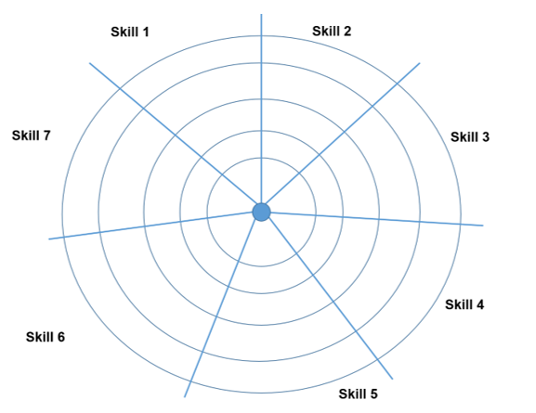
Know the Skills

Slide 60
The Revision Questionnaire

Slide 61
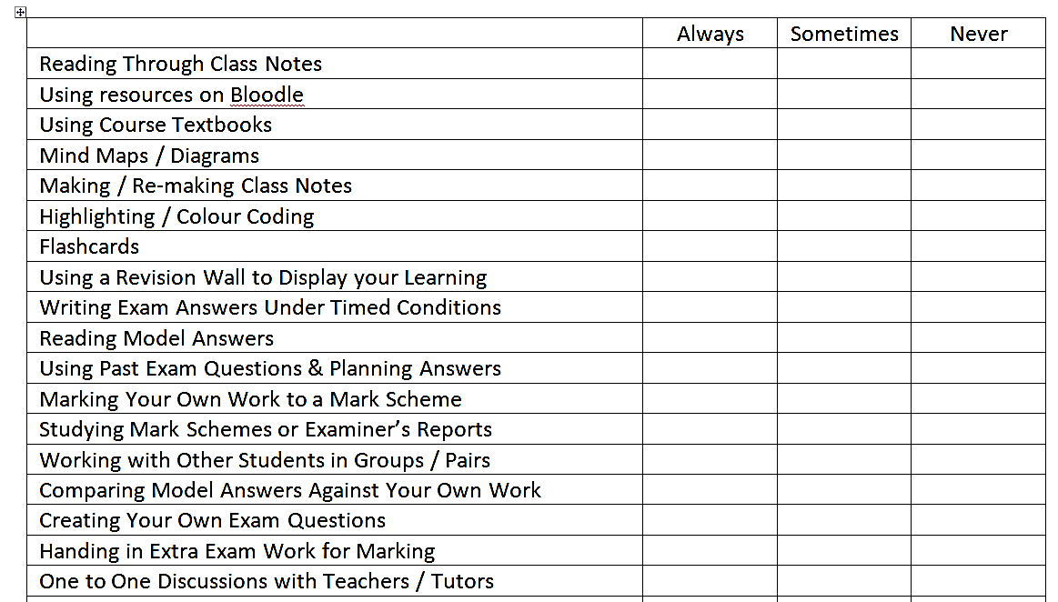

Slide 62
Step One

Slide 63
Step One
Step Two

Slide 64
Step One
Step Two
Step Three

Slide 66
Finding Flow
Flow states feel like:
“nothing else seems to matter. The ego falls away. Time flies… your whole being is involved, and you’re using your skills to the utmost.”
Flow states arrive when engaged in:
“painful, risky, difficult activities that stretched the person’s capacity and involved an element of novelty and discovery.”
Mihaly Csikszentmihalyi, Flow (1991)

Slide 67
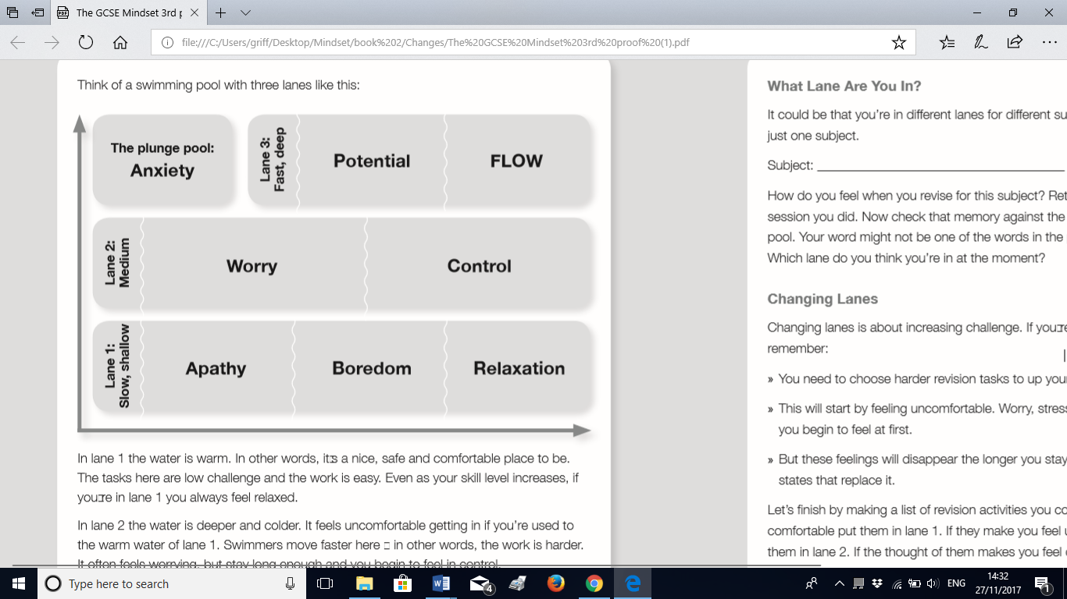

Slide 68
Complete a full paper. Try the
hardest questions you’ve found –
first in note form, then timed.
Do a paper from a different syllabus
Try short exam questions, timed.
Complete an hour of timed exam
work – half a paper.
Regularly review notes. Re-cast
class notes using graphic
organisers. Read course textbooks

Slide 69
Three things a High Practice student in your context does this every lesson/every day/every week….
Completes ‘content’ learning as the course goes on
Gathers past paper questions and attempts sections/full papers
Strategically reviews progress, looks for weaknesses and focuses on them

Slide 70

The low attitude student
Characterised by anger, frustration with progress, unhappiness, self-loathing, negativity – often comparing themselves unfavourably to others

Slide 71
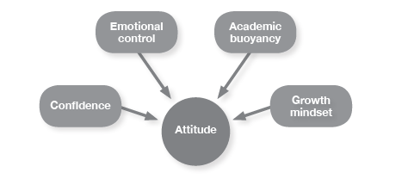
Attitude - Key Principles

Slide 72
Three things a High Attitude student in your context does every lesson/every day/every week….
Low High

Slide 73
Three things a High Attitude student does every lesson/every day/every week….
Audits feedback, seeks out examples of better work
Seeks out help confidently, asks advice – a support network
Goes through tough times but focuses on benefits, successes

Slide 74
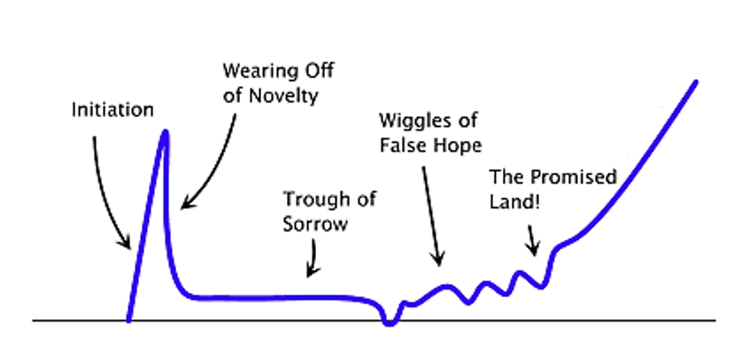
The Process (Graham)

Slide 75
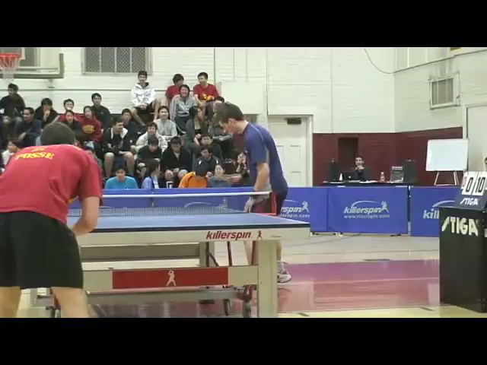
Think Three Positives

Slide 76
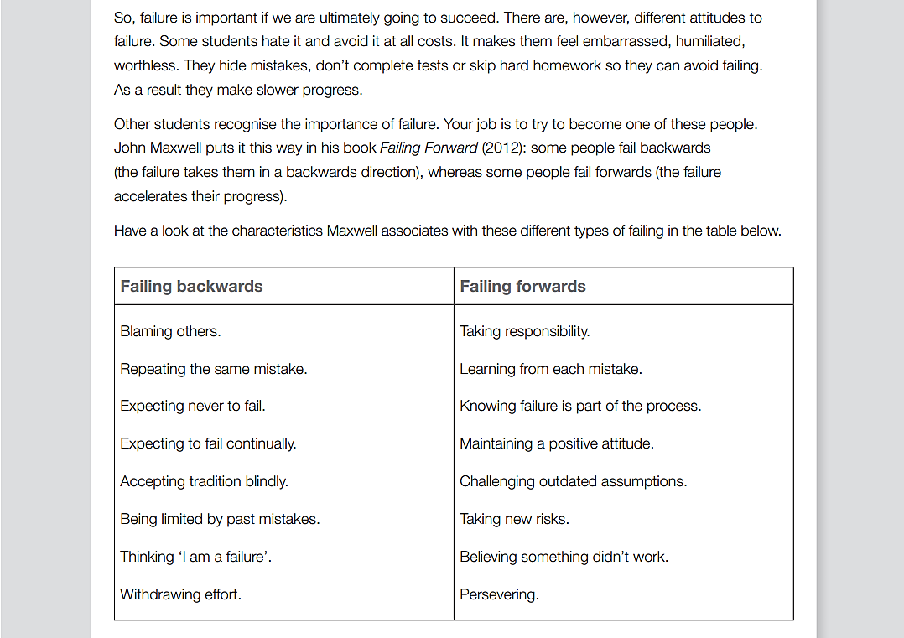

Slide 77
Vision: How well do you know what you want to achieve?
Effort: How many hours of independent work do you do?
Systems: How do you organise your learning and organise your time?
Practice: What kind of work do you do to practice your skills?
Attitude: How do you respond to setbacks?

Slide 78
Implementation
Vision
Effort
Systems
Practice
Attitude

Slide 79
Why? What? How? Who?

Slide 80
Why?
What?
How?
Who?

Slide 81
Packing my bags
PACK
Leave Behind

Slide 82
GLAD | SAD | MAD

Slide 83
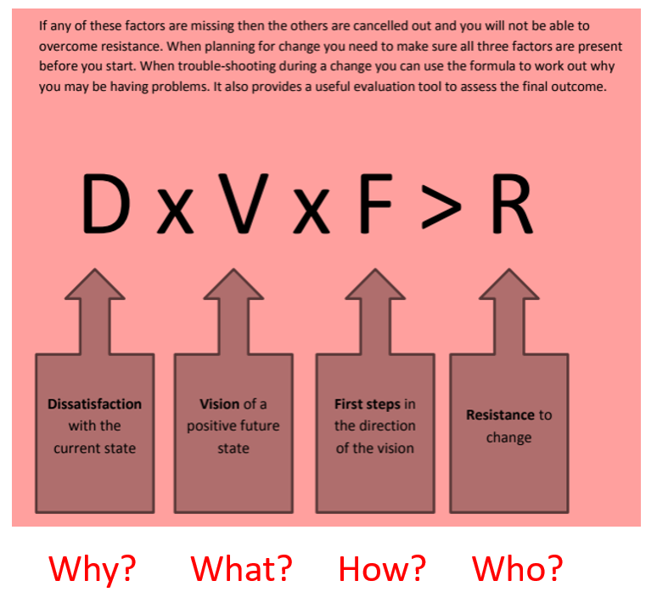
What?

Slide 84
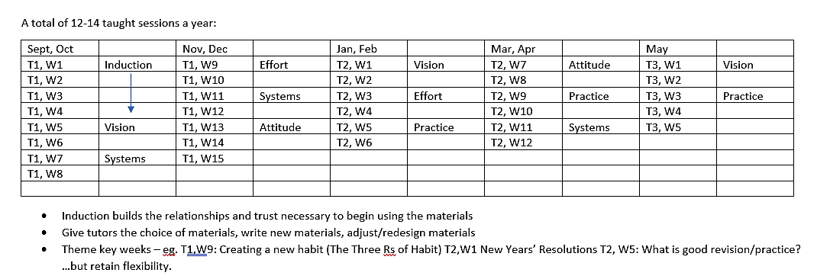
A character curriculum

Slide 86
The Questionnaire
Vision
Effort
Systems
Practice
Attitude

Slide 87
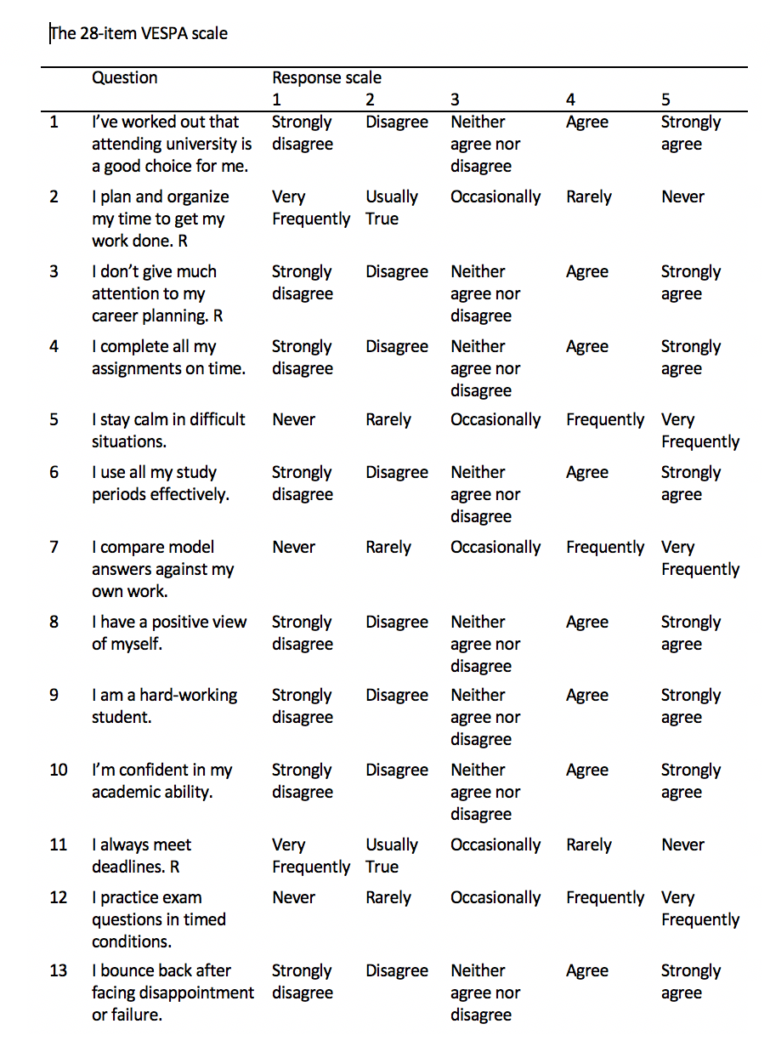

Slide 88
VESPA Questionnaire

Slide 89
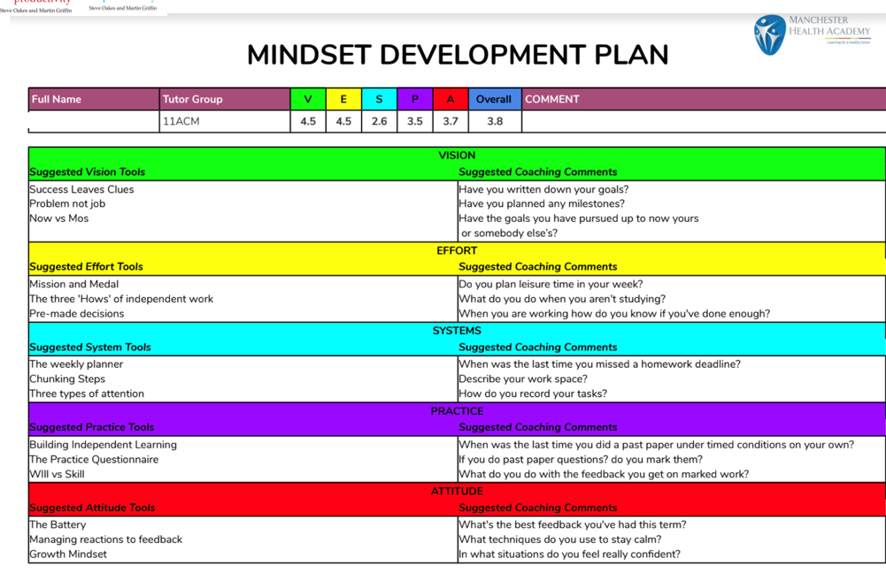

Slide 90
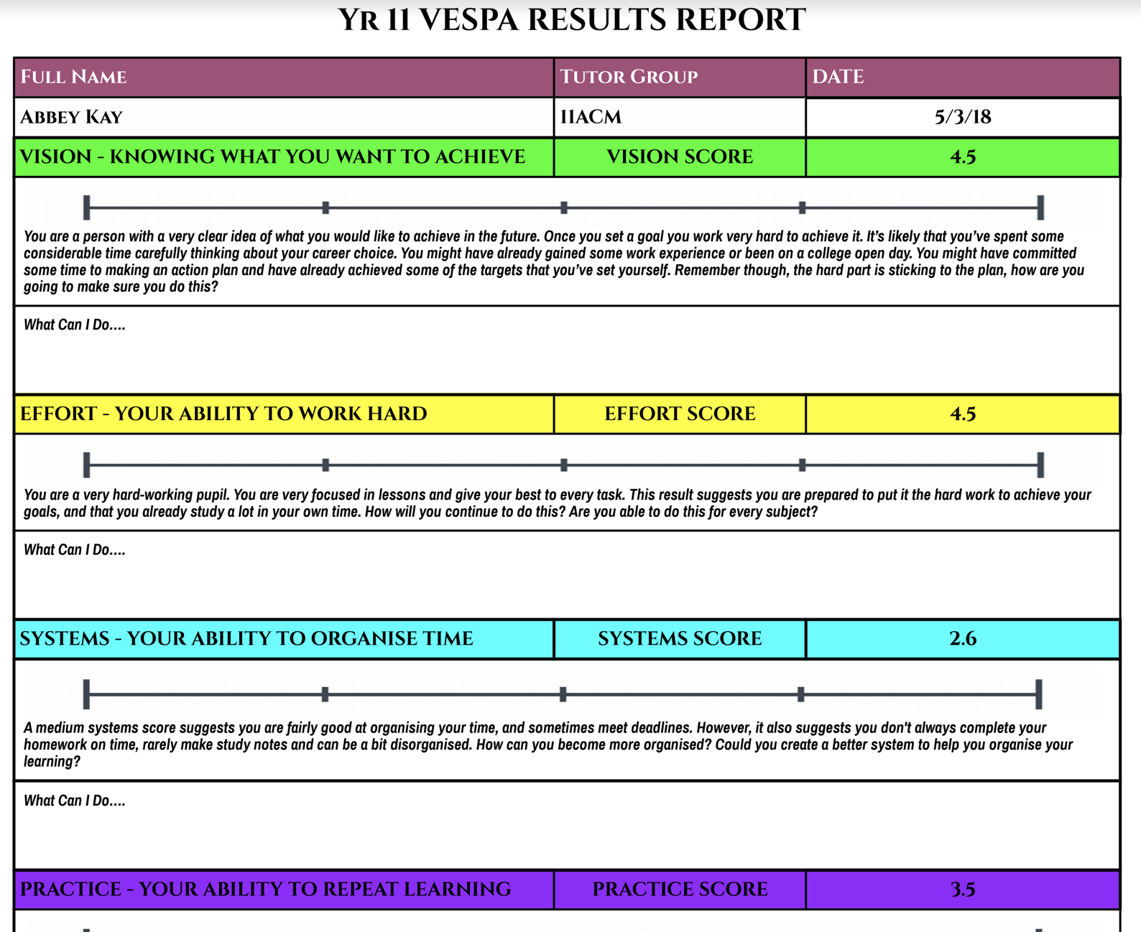

Slide 91
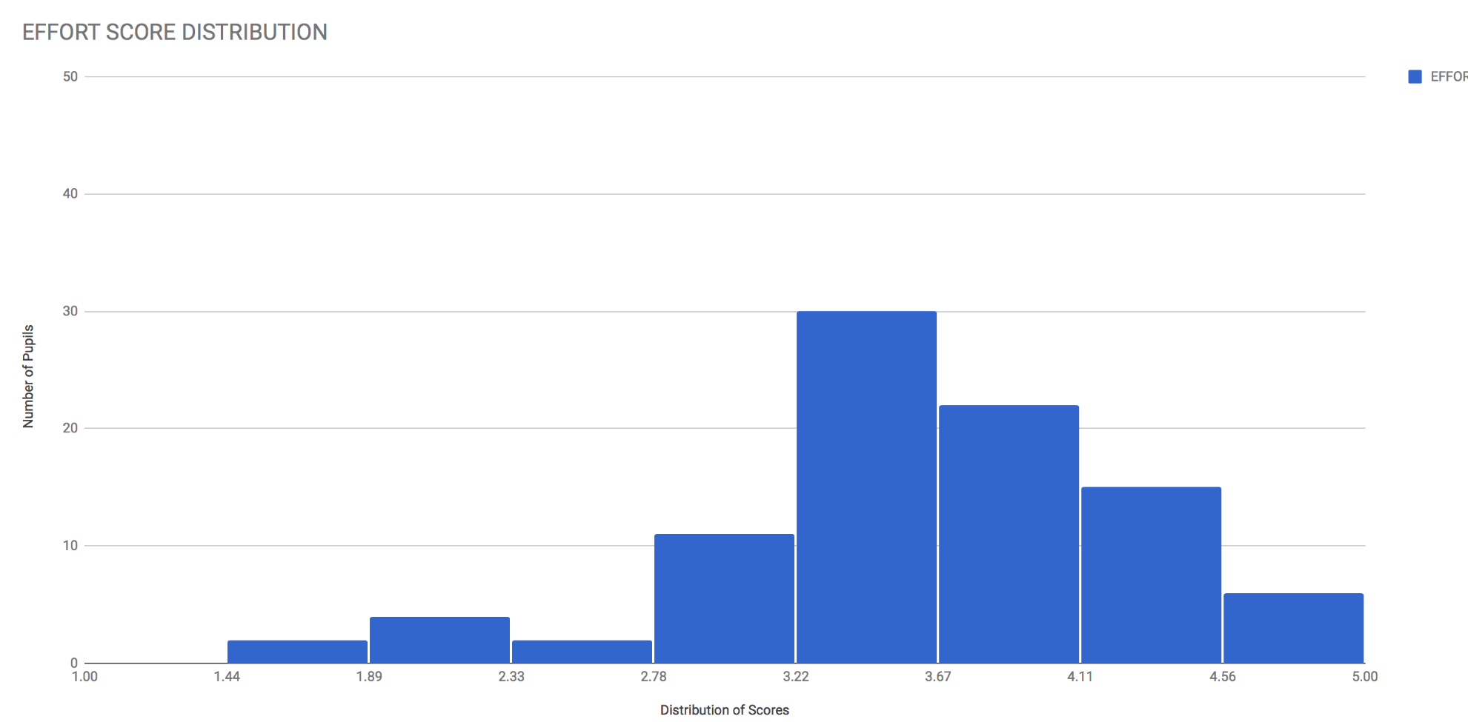
Effort Score Distribution

Slide 92
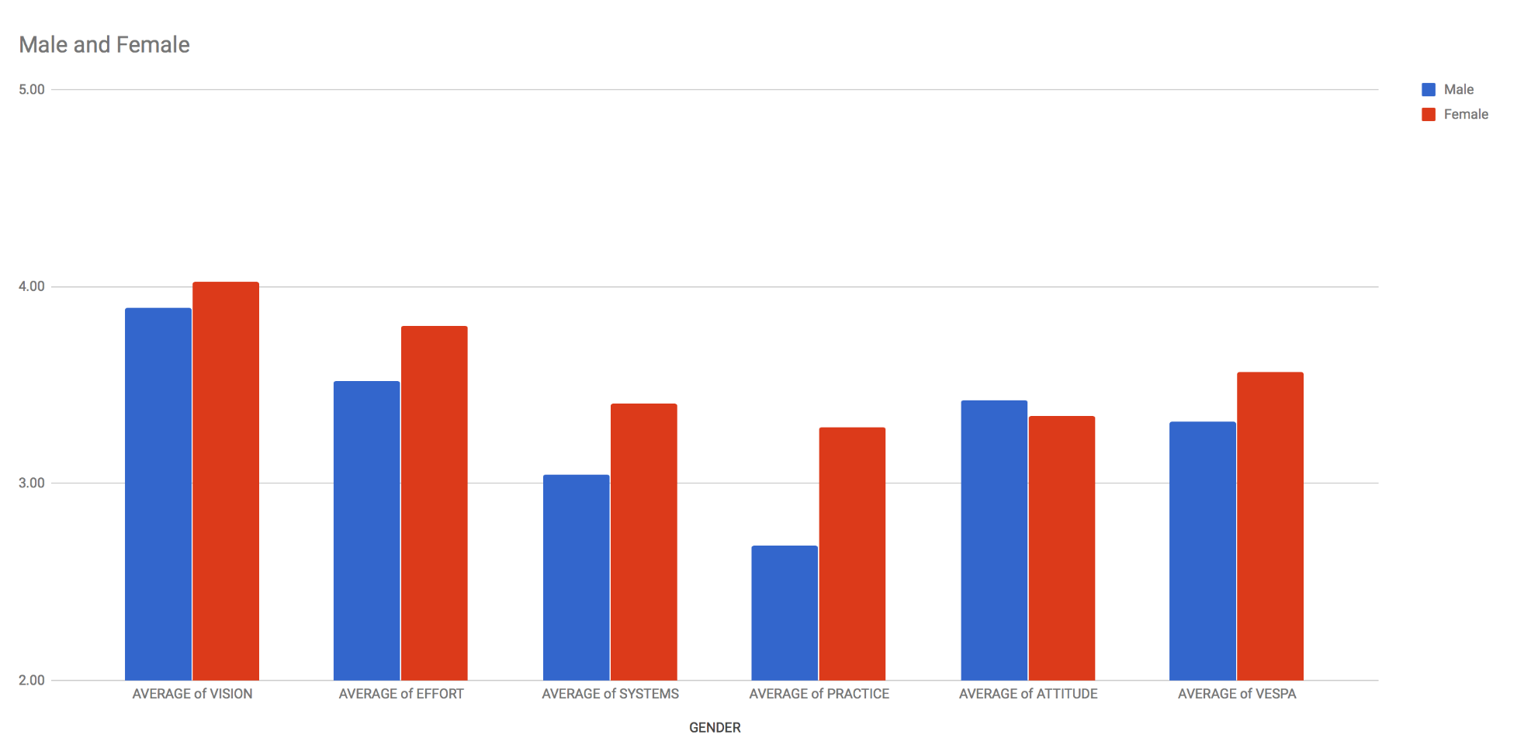
Male and Female

Slide 93
Timeline:
September - December | Induction, trust-building
January | Pre-test
January – May | VESPA curriculum and intervention
June | Post-test
Summer break, exams

Slide 94
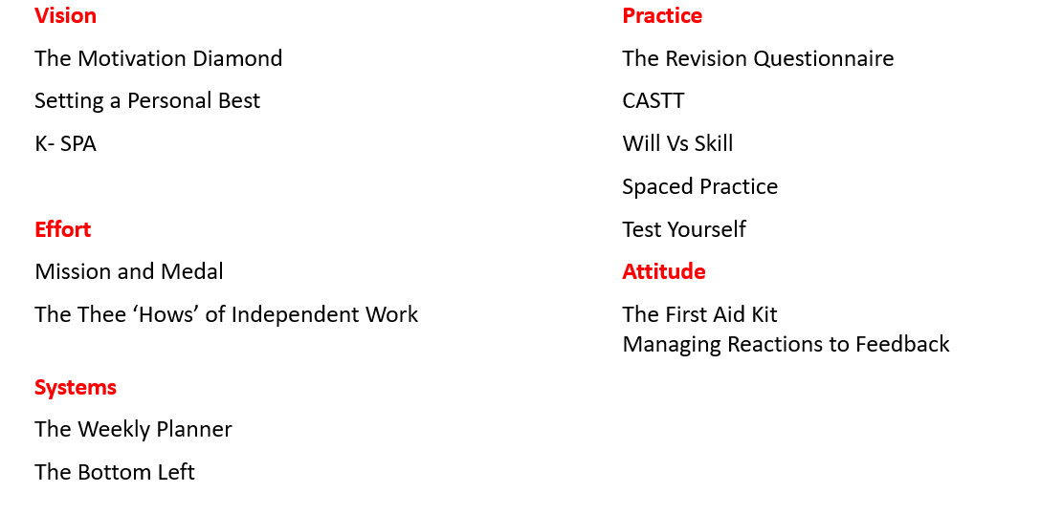
KS4 Curriculum

Slide 95
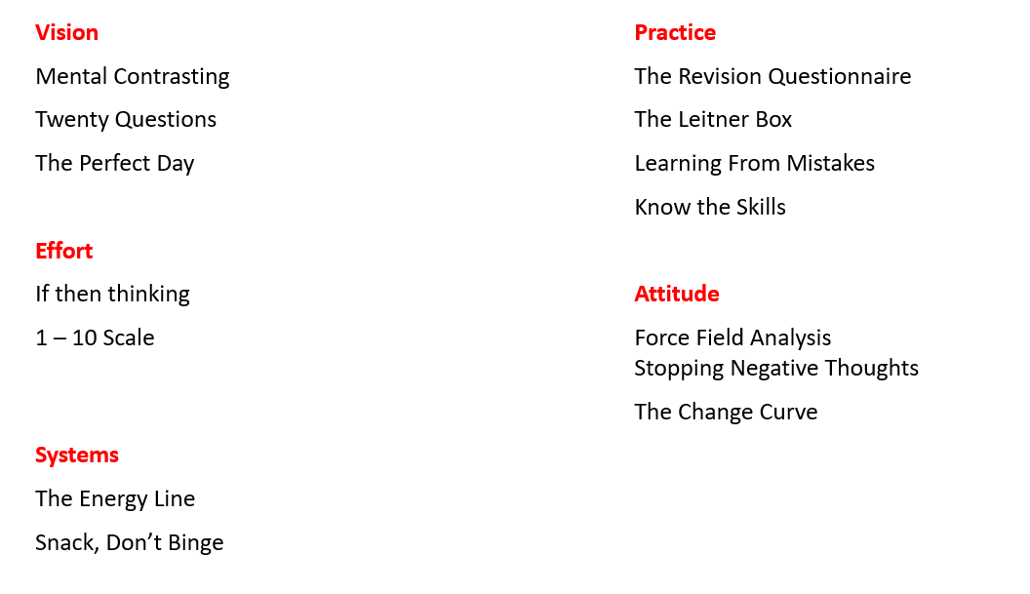
KS5 Curriculum

Slide 96
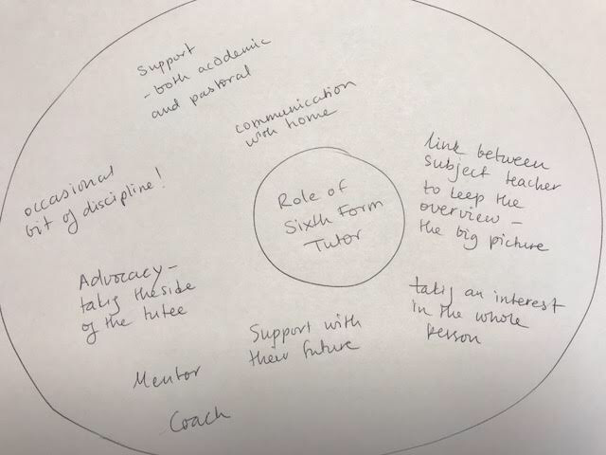
The Role of the Tutor

Slide 97
How?

Slide 98
Methods of Delivery:
1. The pilot Try it with a small and willing group
2. The focus group Ask for a group to pull it apart and modify it
3. The pioneer Find someone already doing it – champion them
4. The full staff launch Powerpoint, first day of term...
5. The drip-drip Newsletters, briefings, conversations, emails...

Slide 99
Methods of delivery:
Delivery through EPQ
Delivery through core (English = September. Topic: vision. Science = October. Topic: systems. Maths = November. Topic: practice.)
Pastoral do Vision, Effort, Attitude. Curriculum cover Systems and Practice.
Start with pastoral – bleed into curriculum through working groups and CPD.

Slide 100
Cultural Transmitters
What does the environment say to the student/staff?
Classrooms
Corridor spaces
Canteen
Common Room
Study areas
Consider:
Furniture
Recreation
Decoration
Posters, fliers, photos and other messages

Slide 101
Cultural Transmitters
What does the language of the organisation say to the student/staff?
Narratives that get repeatedly told
Words repeatedly used
Communication to staff from 6th form team: how, when, in what form? 6th form newsletter
‘Internal’ vs ‘external’ students
Qualities and characteristics emphasised
What is rewarded?

Slide 102
Rewarding the Process
“As I’m sure you know, at A level/GCSE, success is the result of effort. Students who put in the hours, working diligently and optimistically, are the ones who do best.
With this in mind, I have been keen to praise those students who have worked really hard over the last six weeks or so.
--------------- has certainly been one of those students this half term, and I have made it clear how impressed I’ve been! Could I ask you to reinforce this praise at home? A positive word, a gesture or a small reward might really help reinforce this approach to study for next half term as well…”

Slide 103
Who?

Slide 104
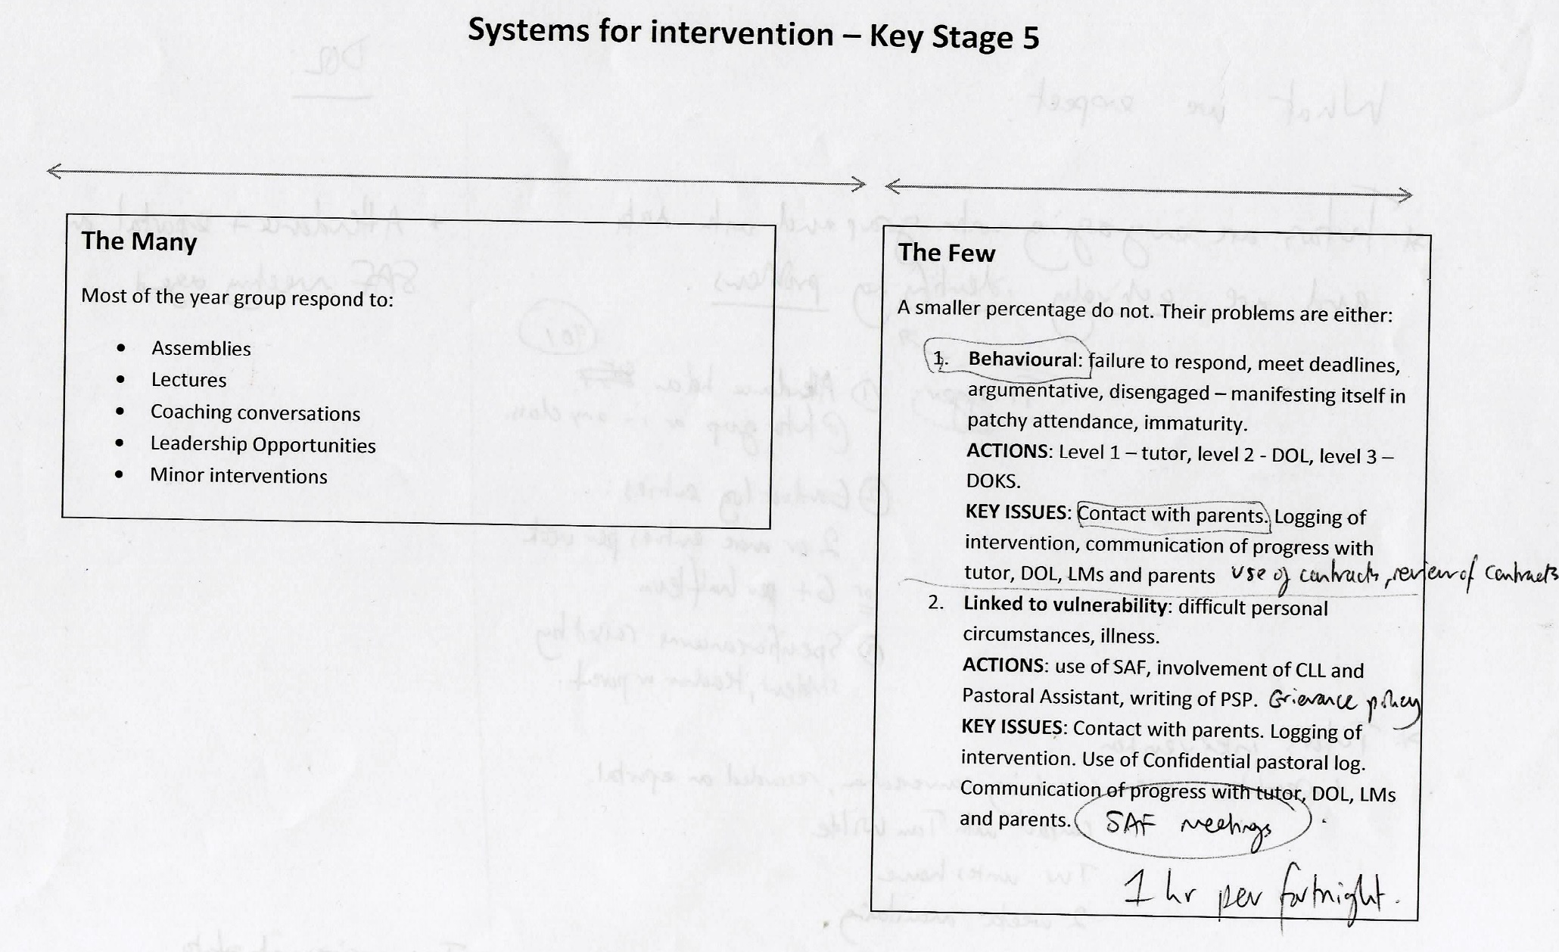
The Many and The Few

Slide 105


Slide 106
The Many and The Few: students
Tutor group membership, the creation of sub-cohorts
Collapsing and combining groups
The centrally delivered lecture
Bespoke or themed interventions for groups or cohorts
Analysis of team members with strengths attached to sub-cohorts
Short –term intervention with parental contact
Leadership: students into teachers
The educational research group

Slide 107
The Many and The Few: staff

Slide 108
Staff Justification
Internal justifications: External justifications:
I need to work out how to engage kids more effectively The kids are all disengaged
We need to audit how we’re spending time There’s no time
I’m used to a much more casual approach, which I like The kids won’t do this
We need to spend some time developing these resources The resources are rubbish
I don’t feel equipped to do this yet I’m not doing this

Slide 109
Engaged, committed to improve
Keen trainees
Leaders
Inexperienced
Experienced
Strugglers
Blockers
Disengaged

Slide 110
The Many and The Few: staff
1. Pairing tutors up to support each other
2. Peer observation of sessions
3. HOSF leads session, tutor observes or team-teaches
4. Team who redesign materials to suit context and culture of school
5. Suspend delivery in a group until trust established. Could be indefinitely? Use as control group short term before fixing the problem later?
6. Back to basics team session: what do kids need from the tutor system at KS5? What’s its purpose and role? What makes a good tutor?
7. Appraisal system

Slide 111
The VESPA Coaching Model
Vision
Effort
Systems
Practice
Attitude

Slide 113
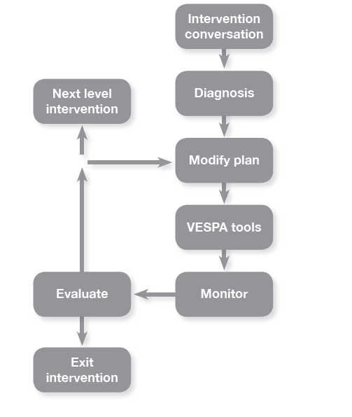
The Coaching Process

Slide 114
The Coaching Process

Slide 115
Intervention conversation:
Not the ‘having a word’ or its variants the telling-off, the setting straight, the going ballistic.
The conversation that tells the student, “I’ve noticed an issue, and it matters. I’m supporting you in changing so you can meet my expectations.”

Slide 116
The Coaching Process

Slide 117
Diagnosis:
Try and establish motive: “What’s the purpose of studying these courses, for you?” and goal “What grades would you like to achieve by the end of these courses?” as well as current reality:
What are you finding hard about study at this level?

Slide 118
“…analysis (thinking) and awareness (observation) are dissimilar mental modes that are virtually impossible to employ simultaneously.” (pg 47)
Tell me about a time when…
Describe to me how…
Tell me the story of….
What does a typical ------ look like?

Slide 119
Types of justification
Internal justifications: External justifications:
I guess I’m not really concentrating Everyone’s noisy
I haven’t been keeping my notes up to date The topics are impossible
I don’t get up early enough, and miss the 8:05 bus The bus is always weirdly early
I’ve lost the trust of my teacher Sir doesn’t like me
I don’t ask questions to clarify my understanding Maths is just so boring

Slide 120
Videos…

Slide 121
The Coaching Process

Slide 122
Planning:
The aim is “not to find the right answer but to create and list as many alternative courses of action as possible.” (pg 79) “…it may be necessary to re-examine the list by noting the benefits and costs of each course of action.” (pg 82) Don’t add ideas without permission. Offer input without undermining self-belief with, “I have another couple of options. Would you like to have them?” (pg 82)

Slide 123
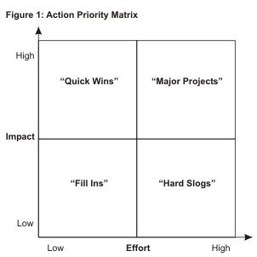
Priority Matrix

Slide 124
The Coaching Process

Slide 125
Commitments:
Responsibility is handed over, helping the student to “optimal clarity and commitment to action.” (pg 18)
What are you going to do?
Will this action help?
What support might you need?
“Rate on a scale of 1-10 the degree of certainty you have that you will carry out the actions agreed.” (pg 87) Then modify to get a higher score.

Slide 126
Contact: alevelmindset@gmail.com
@vespamindset

